Slide 1

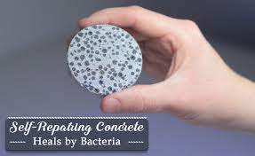
Biology for Engineers
21BE45 Self healing bio concerete
Ms. Supreetha K
Assistant Professor
Department of Biotechnology
Dayananda Sagar College of Engineering
Bangalore
supreetha-bt@dayanandasagar.edu
9916315305

Slide 2
Biology for Engineers
Trends in Bioengineering
Self healing bio concrete
Self healing bio concrete
Concrete is one of the most widely used construction materials and has a high tendency to form cracks.
These cracks lead to significant reduction in concrete service life and high replacement costs.
Although it is not possible to prevent crack formation, various types of techniques are in place to heal the cracks.
It has been shown that some of the current concrete treatment methods such as the application of chemicals and polymers are a source of health and environmental risks, and more importantly, they are effective only in the short term.
Thus, treatment methods that are environmentally friendly and long-lasting are in high demand.
A microbial self-healing approach is distinguished by its potential for long lasting, rapid and active crack repair, while also being environmentally friendly.
Furthermore, the microbial self-healing approach prevails the other treatment techniques due to the efficient bonding capacity and compatibility with concrete compositions.

Slide 3
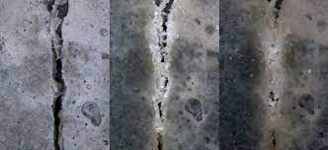
Biology for Engineers
Trends in Bioengineering
Self healing bio concrete
What is Bio-Concrete?
Bio-concrete is a self-healing form of concrete designed to repair its own cracks.
It was developed by Dutch researcher and microbiologist Hendrik Jonkers using an extra ingredient acting as a healing agent and requires no human intervention to be repaired once placed.
Bio-Concrete set to revolutionize the building industry.
His vision was to develop a bionic approach that improves the tensile strength and eco-friendly properties of concrete.
The Dutch researcher set out to develop the bio-concrete of the future with limestone producing bacteria that can survive in a concrete structure for up to 200 years, and which “awaken” when damage occurs, enabling them to heal the cracks.

Slide 4
Biology for Engineers
Trends in Bioengineering
Self healing bio concrete
Self-healing octopus tentacles or plants that create new organisms with offshoots served as inspiration for Jonkers’ invention.
To heal cracks in the concrete, Jonkers chose bacteria (Bacillus pseudofirmus and B. cohnii), that are able to produce limestone on a biological basis.
The positive side-effect of this property: the bacteria consume oxygen, which in turn prevents the internal corrosion of reinforced concrete.
These bacteria do not pose a risk to human health, since they can only survive under the alkaline conditions inside the concrete.
Based on these findings, Jonkers and his team of researchers developed three different bacterial concrete mixtures: self-healing concrete, repair mortar, and a liquid repair system.
In self-healing concrete, bacterial content is integrated during construction, while the repair mortar and liquid system only come into play when acute damage has occurred on concrete elements.

Slide 5
Bio-concrete Preparation
Bio-Concrete mix can be prepared by replacing cement with 5%, 10%, 15% of Rice Hush Ash and 45% of Quarry Dust.
Hay bacillus ( types of Bacteria ) is added to concrete at a proportion of 105 cells/ml.
Hay bacillus exhibits a process known as bio calcification. Bio calcification is a process in which hay bacillus secrets calcium precipitate which consolidates with carbonates present in concrete and form calcium carbonate.
This calcium carbonate fills the inner voids present in the concrete thus making it more compact.
Tests are conducted on these specimens to determine the strength of concrete
In some case Bacterial spores are encapsulated within two to four millimeter wide clay pellets and added to the cement mix with separate nitrogen, phosphorous and a nutrient agent (calcium lactate).

Slide 6
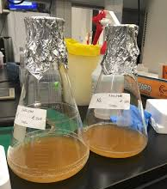
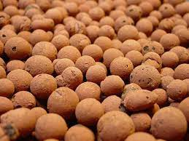
Biology for Engineers
Trends in Bioengineering
Self healing bio concrete
This innovative approach ensures that bacteria can remain dormant in the concrete for up to 200 years.
Contact with nutrients occurs only if water penetrates into a crack and not while mixing cement.
This variant is well-suited for structures that are exposed to weathering, as well as points that are difficult to access for repair workers.
Thus, the need for expensive and complex manual repairs is eliminated.

